Slide 1
Chinook Music Store
About:- The Chinook store is a fictional digital media store that sells music tracks. It offers a variety of music genres, albums, and tracks, providing a realistic dataset to analyse customer purchases, sales trends, and business operations.
SQL + Excel Project

Slide 2
Problem Statements
Revenue Insights
Customer and Employee Insights
Product Insights

Slide 3
Revenue Insights
What is the total revenue generated by all sales?
What is the total revenue generated by each city?
Which genres generate the most revenue, and how does their performance vary across countries?
What is the top 5 total revenue generated by album?
How has monthly revenue changed over the past three years, and what are the significant seasonal patterns or trends?
How does revenue vary across the days of the week?

Slide 4
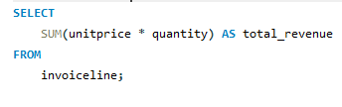
What is the total revenue generated by all sales?
Total Revenue:-
2328.60

Slide 5
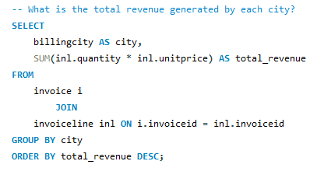
What is the total revenue generated by each city?

Slide 6
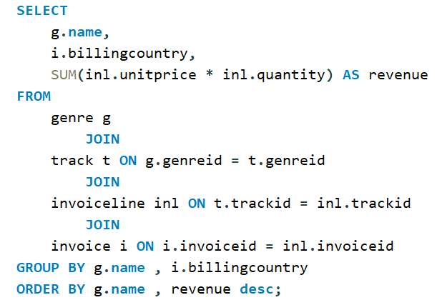
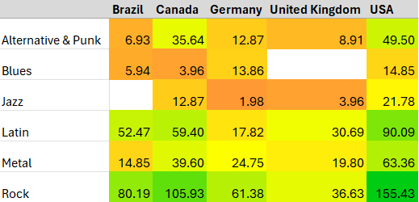
Which genres generate the most revenue, and how does their performance vary across countries?
Rock is the most revenue-generating genre across all countries, with the USA contributing the highest revenue (155.43), followed by Canada (105.93). Latin music is the second most popular genre overall, with significant contributions from the USA (90.09) and Canada (59.4).

Slide 7
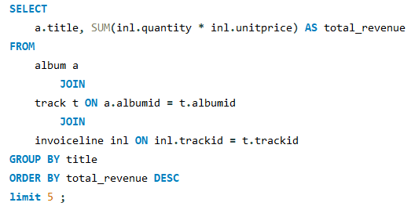
What is the top 5 total revenue generated by album?
The album Battlestar Galactica (Classic), Season 1 generates the highest revenue (35.82), outperforming other albums, with Minha Historia following closely at 34.65,

Slide 8
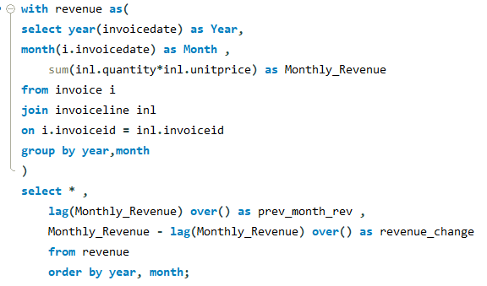
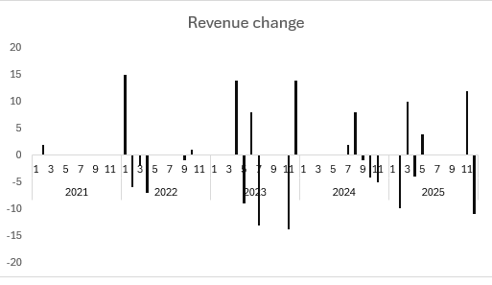
How has monthly revenue changed over the past three years?
Monthly revenue shows notable fluctuations, with significant peaks occurring in April 2022 (+15.00) and June 2023 (+8.00). There is also a recurring seasonal dip in revenue during November of each year (e.g., -13.86 in November 2023)

Slide 9
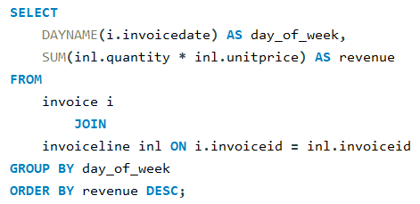
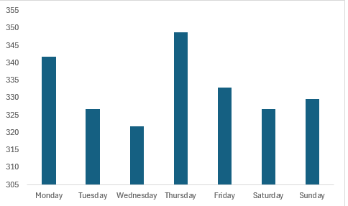
How does revenue vary across the days of the week?
Thursdays generate the highest revenue (348.78), while Wednesdays have the lowest revenue (321.81)

Slide 10
Customer and Employee Insights
Who are the top 5 customers in terms of total purchases?
Which customers have not made a purchase in the last year?
What is the total number of customers assigned to each employee?
Which employee generates the most revenue?

Slide 11
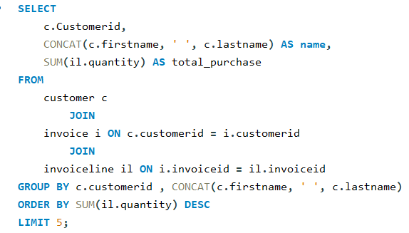
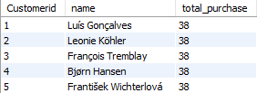
Who are the top 5 customers in terms of total purchases?
The top 5 customers—Luís Gonçalves, Leonie Köhler, François Tremblay, Bjørn Hansen, and František Wichterlová—are tied with a total of 38 purchases each

Slide 12
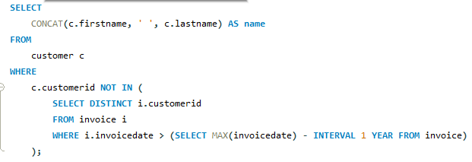
Which customers have not made a purchase in the last year?
Names
Leonie Köhler
Fernanda Ramos
Jennifer Peterson
Jack Smith
Tim Goyer
João Fernandes
Hannah Schneider
Niklas Schröder
Dominique Lefebvre
Joakim Johansson
Mark Taylor
Luis Rojas
Puja Srivastava

Slide 13
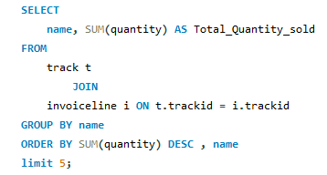
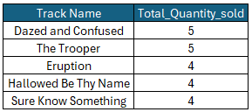
Which is the most sold track in terms of quantity?

Slide 14
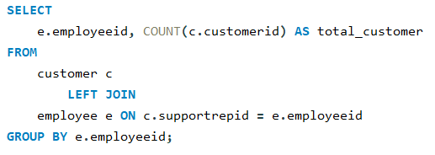

What is the total number of customers assigned to each employee?

Slide 15
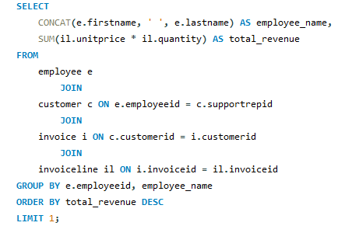

Which employee generates the most revenue?

Slide 16
Product Insights
Which is the most sold track in terms of quantity?
What are the top 3 most popular genres by total track sales?
How does sales performance compare across different media types?

Slide 17
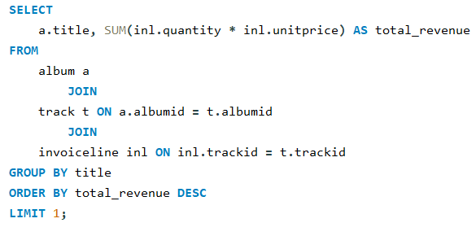

Highest revenue album

Slide 18
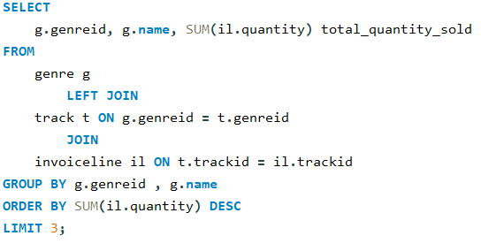
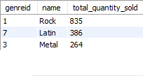
What are the top 3 most popular genres by total track sales?
Rock have the Highest Quantity Sold which is 835 units followed by latin with 386 and Metal with 264

Slide 19
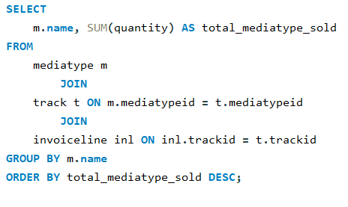
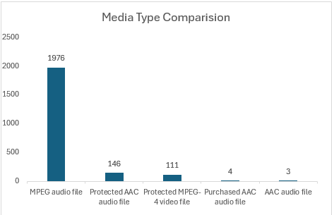
How does sales performance compare across different media types?
MPEG audio files dominate the media type sales, with 1976 quantity sold.

Slide 20
Recommendation
Focus on promoting Rock music in the USA through exclusive bundles and artist collaborations, as it generates the highest revenue overall.
Increase marketing efforts for the Latin genre in Brazil and Canada, leveraging its strong performance in these countries with regional campaigns.
Launch mid-week promotions on Wednesdays targeting underperforming days, emphasizing discounts on Metal and Jazz tracks via digital media formats.
Address the seasonal revenue dip in December by offering holiday-themed promotions and discounts on popular albums and genres.

Slide 21
Thank You

